Slide 1
CHAPTER 4 Optimal Predictive Control 11 Using an observer for disturbance estimation
Anthony Rossiter

Slide 2
Introduction
The previous videos demonstrated the use of an independent model in order to give ‘effective’ state/disturbance estimation and to facilitate unbiased predictions.
While this allowed good disturbance rejection, one could very easily query the sensitivity of the approach for which no insight is yet available.
This video demonstrates code for the common alternative of a simple observer for estimating both the system states and the disturbance.

Slide 3
Estimating the state
The process model is assumed to be:
An observer needs to estimate both x and d, so a suitable augmented model is given as.

Slide 4
Observer dynamics
The augmented process model is assumed to be:
An observer uses the difference between its own output and the process measured output, that is:
This video does not concern itself with the selection of L, or indeed more advanced observer designs.

Slide 5
Control law
The control law giving no offset in the steady-state has been defined as:
The observer is used to estimate both x_{k} and d.

Slide 6
Compact control law
The control law can be given in a more compact form if desired.

Slide 7
Assume modelling errors and a non-zero disturbance which must be estimated. [Run with and without modelling errors] Disturbance estimate does not match actual disturbance as it also caters for parameter uncertainty to ensure unbiased prediction.

Slide 8
video4_11_example1.m video4_11_example2.m
OMPC/SOMPC simulation, SISO/MIMO system, introduce a target change, a disturbance change and parameter uncertainty.
OBSERVATIONS
Disturbance estimate and actual disturbance differ, even while disturbance is zero.
Nevertheless, offset free tracking is obtained both for non-zero targets and disturbance rejection.
Control law may not be robust.

Slide 9
May be interesting to contrast the two approaches: Using an observer. Using an independent model.
Should be identical in the nominal case of no parameter uncertainty and no disturbances.
However, have very different sensitivity to uncertainty (parameter, disturbance, noise).

Slide 10
video4_11_example3.m video4_11_example4.m
OMPC/SOMPC simulation, SISO/MIMO system, introduce a target change, a disturbance change, measurement noise and parameter uncertainty. Overlay responses with different prediction models.
OBSERVATIONS
Use of independent model vs observer do give different responses in the uncertain case.
There has been no formal robust design attempted as yet so we will not suggest either is better for now.

Slide 11
Conclusions
Demonstrated code for introducing an observer to estimate system states and a ‘disturbance’ value that can be used to ensure unbiased prediction.
Noted that use of the observer in conjunction with a deviation form of the control law ensures offset free tracking in the uncertain case.
Sensitivity is different to that obtained when using an independent model to ensure unbiased predictions and state estimation.

Slide 12



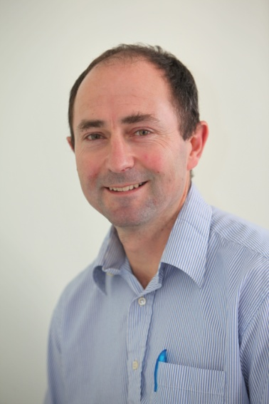
Anthony Rossiter
Department of Automatic Control and Systems Engineering
University of Sheffield
www.shef.ac.uk/acse
© 2014 University of Sheffield
This work is licensed under the Creative Commons Attribution 2.0 UK: England & Wales Licence. To view a copy of this licence, visit http://creativecommons.org/licenses/by/2.0/uk/ or send a letter to: Creative Commons, 171 Second Street, Suite 300, San Francisco, California 94105, USA.
It should be noted that some of the materials contained within this resource are subject to third party rights and any copyright notices must remain with these materials in the event of reuse or repurposing.
If there are third party images within the resource please do not remove or alter any of the copyright notices or website details shown below the image.
(Please list details of the third party rights contained within this work.
If you include your institutions logo on the cover please include reference to the fact that it is a trade mark and all copyright in that image is reserved.)

